Slide 1
NDFA to DFA Conversion

Slide 2
Problem Statement
Let X = (Q_{x}, ∑, δ_{x}, q₀, F_{x}) be an NDFA which accepts the language L(X). We have to design an equivalent DFA Y = (Q_{y}, ∑, δ_{y}, q₀, F_{y}) such that L(Y) = L(X).

Slide 3
The following procedure converts the NDFA to its equivalent DFA −
Input − An NDFA
Output − An equivalent DFA
Step 1 − Create state table from the given NDFA.
Step 2 − Create a blank state table under possible input alphabets for the equivalent DFA.
Step 3 − Mark the start state of the DFA by q0 (Same as the NDFA).
Step 4 − Find out the combination of States {Q₀, Q₁,... , Q_{n}} for each possible input alphabet.
Step 5 − Each time we generate a new DFA state under the input alphabet columns, we have to apply step 4 again, otherwise go to step 6.
Step 6 − The states which contain any of the final states of the NDFA are the final states of the equivalent DFA.

Slide 4
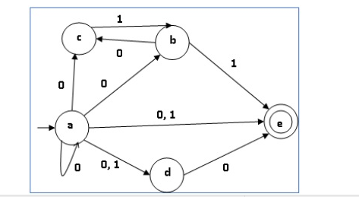
Example

Slide 5
State table of the NFA
q | δ(q,0) | δ(q,1)
a | {a,b,c,d,e} | {d,e}
b | {c} | {e}
c | ∅ | {b}
d | {e} | ∅
e | ∅ | ∅

Slide 6
Using the above algorithm, we find its equivalent DFA. The state table of the DFA is shown in below.
q | δ(q,0) | δ(q,1)
[a] | [a,b,c,d,e] | [d,e]
[a,b,c,d,e] | [a,b,c,d,e] | [b,d,e]
[d,e] | [e] | ∅
[b,d,e] | [c,e] | [e]
[e] | ∅ | ∅
[c, e] | ∅ | [b]
[b] | [c] | [e]
[c] | ∅ | [b]

Slide 7
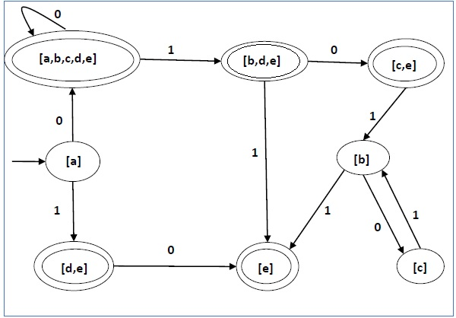
The state diagram of the DFA is as follows −

Slide 8
